Slide 1
m2m air
Cloud
Telit
Mobile App
By Kimaia

Slide 2
Web 2 Mobile migration issues
Mobile focus:
  Monitor – any time, any where
  Immediate response
  Admin ?

Slide 3
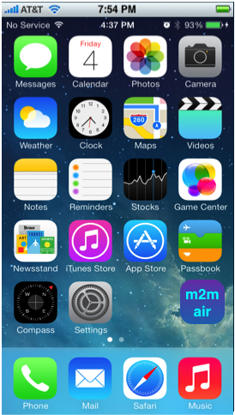
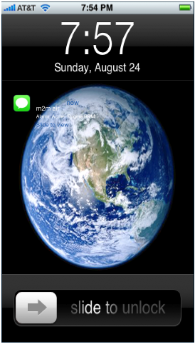
Usage flows & Entry points
  Monitor –
  user initiated entry
  Response –
  system push initiated entry

Slide 4
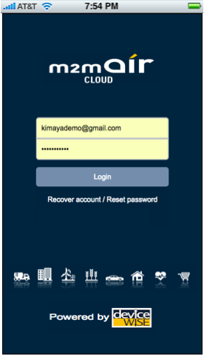
Login view
  Entry point when logged out.
  Mobile vs. Web usage
    Login – Logout

Slide 5
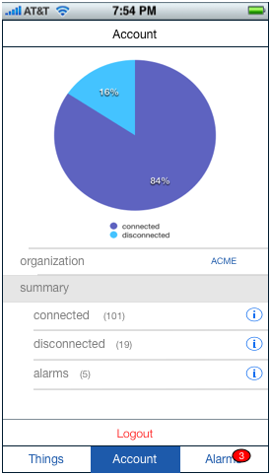
Account view
  Conforms with web portal’s conventions.
    discussion
  Account summary items – clickable.
  Nav & Tabs bar.
  Logout (single exit point).
Account settings
  Organization picker
  Summery items ?
  Tag cloud filtering
  On Logout, account settings are set for login.

Slide 6
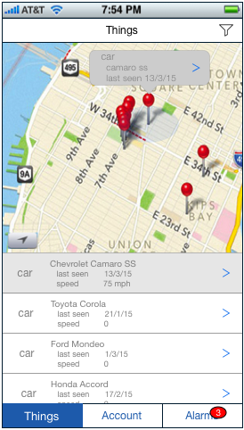
Things view
  Map / Map&Table view.
  Tap a pin for a Thing preview.
  Click a preview arrow to drilldown on a Thing.
  Apply filtering on Things set.

Slide 7
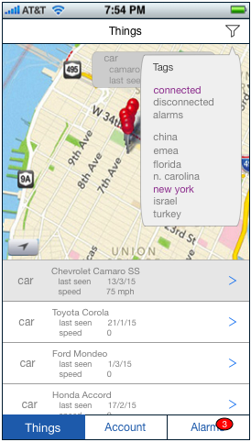
Things view
  Filtering
    Tags cloud filtering
      and / or query?
    Free search query? (e.g. ‘Toyota’)

Slide 8
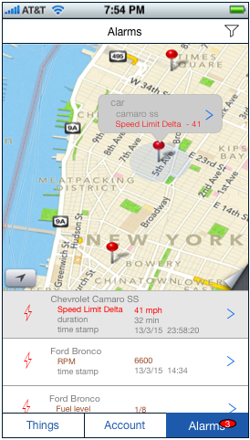
Alarms view
  Map / Map&Table view.
  Tap a pin for a Thing’s Alarm preview.
  Click a preview arrow to drilldown on an Alarm.
  Apply filtering on Alarms set.

Slide 9
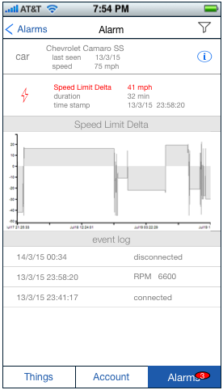
Alarm view
  Containing Thing’s preview – clickable.
  Alarm description.
    Items ?
  Alarmed property graph view
  Thing’s Event log

